Slide 1




Marketing Campaign Data Analysis using Excel
STUDENT NAME:S.NIVEDHA
REGISTER NO:422200035
DEPARTMENT:B.COM(ISM)
COLLEGE:S.I.V.E.T COLLEGE

Slide 2

.
Marketing Campaign Data Analysis Using Excel

Slide 3


AGENDA
Problem Statement
Project Overview
End Users
Our Solution and Proposition
Dataset Description
Modelling Approach
Results and Discussion
Conclusion
3/21/2024 Annual Review

Slide 4


PROBLEM STATEMENT
A marketing campaign problem statement is a clear and concise description of a problem or issue that a company faces, and it's an important tool for ensuring that everyone working on a project knows what they need to address. A well-written problem statement should:
Identify the current state: Describe the current situation
Identify the desired future state: Describe what the desired outcome is
Identify the gap: Describe the gap between the current state and the desired future state

Slide 5

PROJECT OVERVIEW
1.campaign goals and how you’ll measure them
2.your audience and what you know about them
3.creative requirements and key messages
4.responsibilities across the team

Slide 6

WHO ARE THE END USERS?
1.The end-user refers to the ultimate person who consumes a product or service. This term offers a sense of distinction between the individual who buys and makes use of goods or services, and the ones who design, develop, or manufacture the product.
2.For developing an excellent product or service, the individuals who design, formulate, research, and promote the product or service should prioritize the preferences and needs of end-users, rather than their own.

Slide 7

OUR SOLUTION AND ITS VALUE PROPOSITION
A value proposition in marketing is a concise statement of the benefits that a company is delivering to customers who buy its products or services. It serves as a declaration of intent, both inside the company and in the marketplace.
Here are some tips for writing a value proposition:
Be clear and concise: Focus on the main points and communicate them clearly.
Target the audience: Make sure the content speaks to the target audience.
Focus on benefits: Tell customers what they'll get, rather than just explaining the features.
Avoid jargon: Interview customers to learn how they talk about the product and use that language in the messaging.

Slide 8
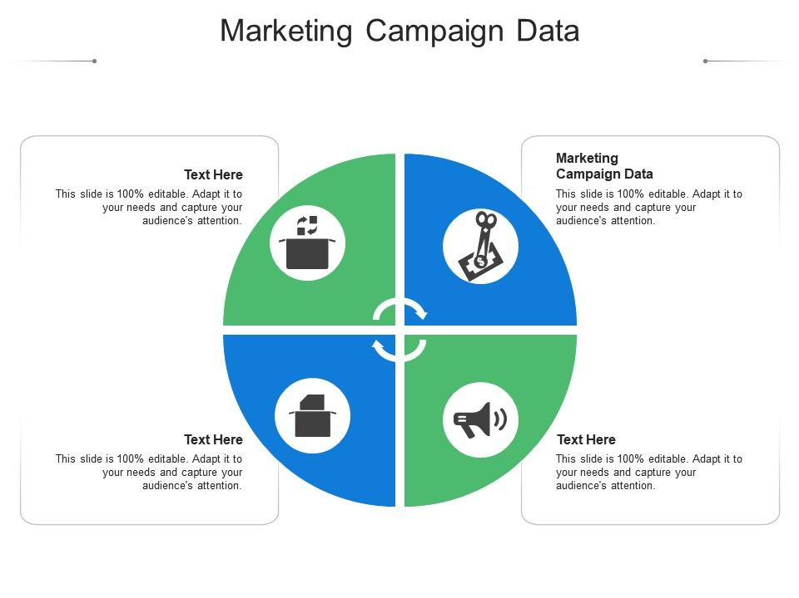
Dataset Description

Slide 9

THE "WOW" IN OUR SOLUTION
Strategy: Help make the health care system easier to navigate, and show people that they can easily use health care in everyday occurrences with money savings, time savings, and finding care.
Creative Direction: Connect with life instances that occur easily every day to show that health care is quite often about a simple every day occurrence like sunburn, and therefore everyone should know how to get care.
Creative Solution: Use images that instantly connect with people (e.g. puppy nibbles, kid hitting piñata) and connect people with the realization that there are Medical Billing Codes for nearly everything like, "Adverse Effects of Work Environment." The codes exist because they’re used, which is a risk for everyone.
3/21/2024 Annual Review
9

Slide 10
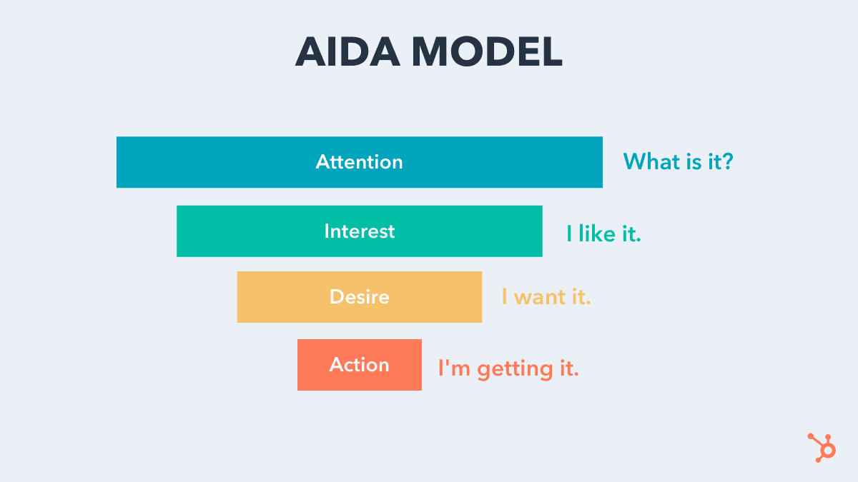
MODELLING
10

Slide 11
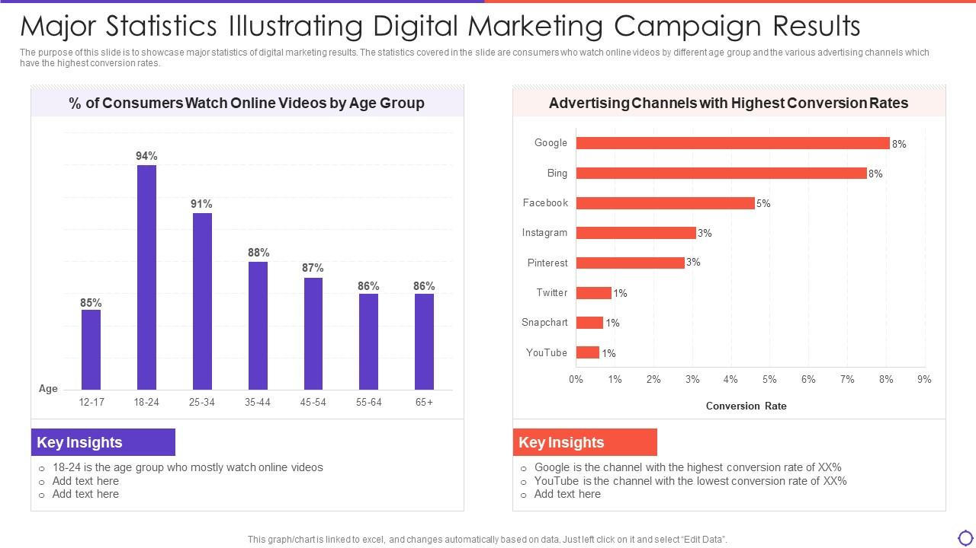
RESULTS
11

Slide 12
Conclusion
which discusses marketing planning roles, the parts and functions of the marketing plan, forecasting, and the structure of a marketing plan audit. It also discusses PEST Analysis and other external factors that affect marketing decisions. This chapter reviews other concepts we've discussed so far. Key takeaways include the steps in the forecasting process. You will be able to identify types of forecasting methods and their advantages and disadvantages and discuss the methods used to improve the accuracy of forecasts.

